Slide 1

Telecom Egypt
Governance Maturity
Governance, Risk & Digital Transformation

Slide 2

Project Overview
h
Objective
Assess the governance maturity level of Telecom Egypt and evaluate its institutional effectiveness.
Focus Areas
Governance Effectiveness
Risk Management
Digital Transformation
Outcome
Strategic recommendations to enhance governance, sustainability, and long-term growth

Slide 3

Why Telecom Egypt?
📅
☁️
💰
👥
📡
Established
Employees
Subscribers
Services
2026 Revenue
1854
50,000+
18M+
• Fixed • Mobile
• Internet • Cloud
88 Bn EGP (Projected)
Success
Eng. Ola Elsheikh Governance & Digital Transformation Ambassadors Program

Slide 4

Company Growth
Telecom Egypt’s revenue increased from 31 to 88 billion EGP between 2020 and 2026, reflecting strong market expansion and digital transformation.
2021 → 38 Bn
2025 → 77 Bn
2022 → 44 Bn
2020 → 31 Bn
2024 → 67 Bn
2026 → 88 Bn
2023 → 56 Bn
Eng. Ola Elsheikh Governance & Digital Transformation Ambassadors Program

Slide 5
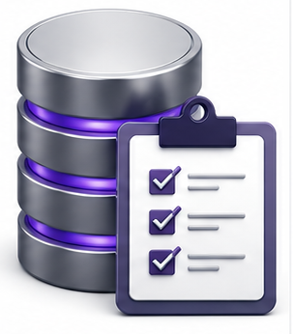
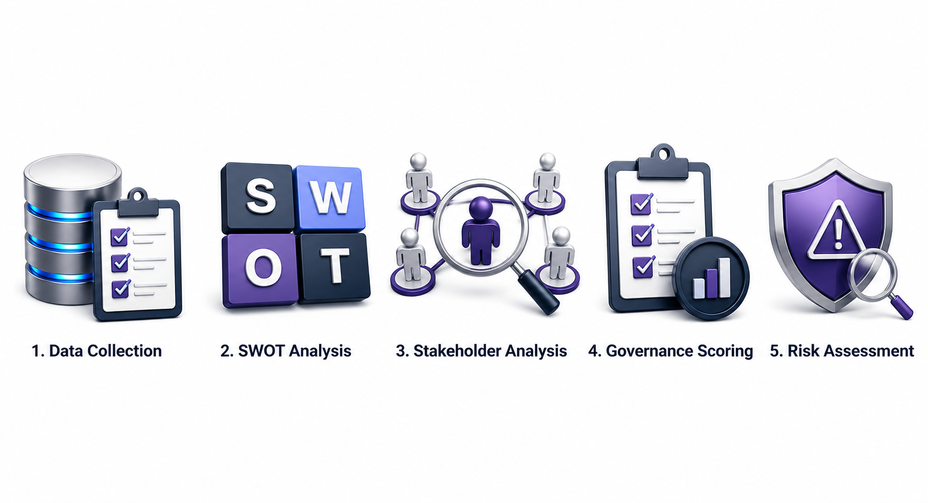
Assessment Methodology
Data Collection
SWOT Analysis
Stakeholder Analysis
Collecting data from annual reports, public disclosures, and industry benchmarks to build the assessment foundation.
Evaluating organizational strengths, weaknesses, opportunities, and threats affecting strategic performance.
Identifying key stakeholders and analyzing their influence, interest, and impact on governance decisions.
Governance Scoring
Risk Assessment
Assessing governance principles using a maturity scoring model based on qualitative evaluation.
Identifying major risks and evaluating their probability and impact on organizational sustainability.
Eng. Ola Elsheikh Governance & Digital Transformation Ambassadors Program

Slide 6
KEY STRATEGIC ANALYSIS
SWOT ANALYSIS
S
-Largest fixed network in Egypt.
W
-Bureaucratic structure
-Slow decision cycles
-Legacy systems
T
-Strong competitions
Cyberattacks
-Regulatory changes
-Rapid tech disruption
O
-AI integration
-5G expansion
-Smart cities
-Cloud market growth.
-Strong government support.
-Huge infrastructure assets.
-Strong market position.
The SWOT analysis highlights Telecom Egypt’s strong internal position supported by extensive infrastructure and government backing. Promising opportunities in AI, 5G, smart cities, and cloud services can accelerate future growth. However, internal inefficiencies and external threats such as competition, cyberattacks, and regulatory changes require proactive strategic management.
STRENGTHS
WEAKNESSES
STRENGTHS
WEAKNESSES
OPPORTUNITIES
THREATS
Eng. Ola Elsheikh Governance & Digital Transformation Ambassadors Program

Slide 7

STAKEHOLDER MATRIX
Stakeholder Analysis
KEEP STATSIFIED
MANAGE CLOSELY
Suppliers
Government
Regulators
Investors
• Government and regulators have the
highest influence.
• Customers and employees require continuous engagement.
• Suppliers support operational stability.
• Media affects public reputation and brand perception.
INFLUENCE/POWEROF
Ability to influence organization
KEEP INFORMED
MONTOR
Customers
Employees
Media
Level of impact on organization
INTEREST /IMPACT
Eng. Ola Elsheikh Governance & Digital Transformation Ambassadors Program

Slide 8
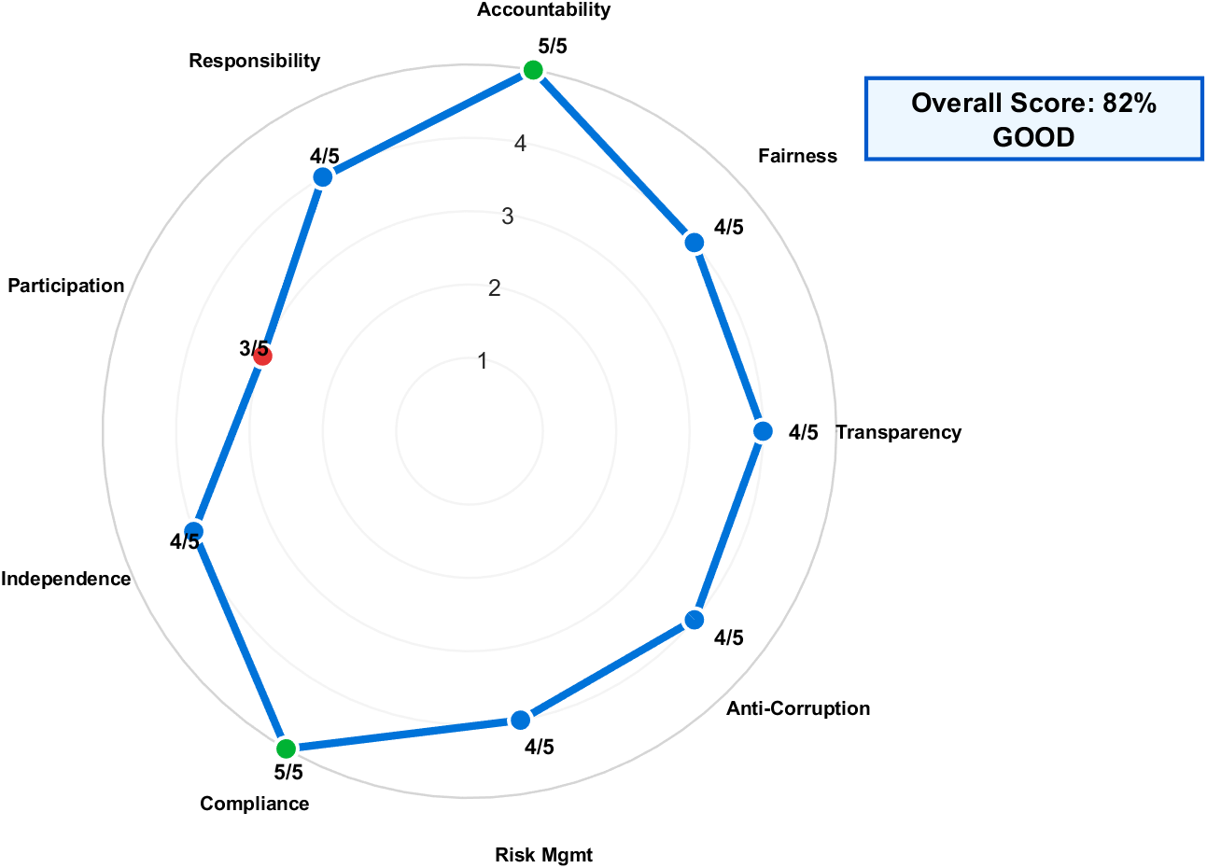
RADER MATRIX
Rader analysis
The governance scoring model shows balanced performance across nine governance principles, with an overall score of 37/45 (82%), placing Telecom Egypt within the Good Governance Maturity category.
Eng. Ola Elsheikh Governance & Digital Transformation Ambassadors Program

Slide 9
RADER MATRIX
Metric | Result | Metric | Result
Highest Score | Accountability & Compliance (5/5) | Highest Score | Accountability & Compliance (5/5)
Average Score | 82% | Average Score | 82%
Weakest Area | Participation (3/5) | Weakest Area | Participation (3/5)
Maturity Level | Good Governance | Maturity Level | Good Governance
Eng. Ola Elsheikh Governance & Digital Transformation Ambassadors Program

Slide 10
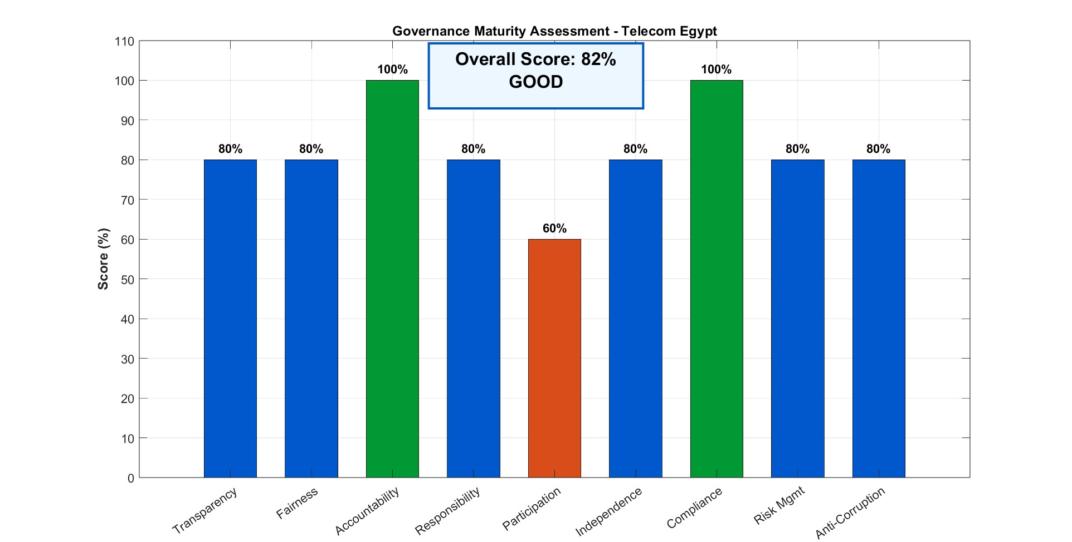
GOVERNANCE ASSESSMENT
Governance Maturity Score
80%
100%
60%
80%
80%
Tranceperancy & fairness
Accountability & compliance
Participation
Responsibility & independence
Risk matrix & Anti-corruption
Eng. Ola Elsheikh Governance & Digital Transformation Ambassadors Program

Slide 11

RISK MATRIX
HIGH
10
Cyberattack
Risk | Probability | Impact | Risk
Cyberattack | 9 | 10 | Cyberattack
Regulation | 8 | 7 | Regulation
Competition | 7 | 8 | Competition
Operational Failure | 5 | 6 | Operational Failure
8
Market Competition
IMPACT
Regulatory Risk
7
6
Operational
Failure
LOW
5
7
9
10
HIGH
PROBABILITY
Eng. Ola Elsheikh Governance & Digital Transformation Ambassadors Program

Slide 12

RECOMMENDATIONS
1
AI-Driven Governance Analytics
2
Stakeholder Engagement Enhancement
3
Smart Compliance Automation
Monitor governance KPIs in real time
Improve strategic decision-making
Enable predictive risk detection
Expand digital feedback channels
Improve participation in governance
Increase organizational transparency
Track regulations automatically
Reduce compliance delays
Strengthen internal controls
Cyber Resilience Framework
5
ESG Integration Strategy
4
Enhance threat detection systems
Improve incident response readiness
Reduce cyberattack exposure
Improve sustainability reporting
Support responsible growth
Strengthen investor confidence
Eng. Ola Elsheikh Governance & Digital Transformation Ambassadors Program

Slide 13
MATLAB Highlights
%% Main radar line
polarplot(theta,r,...
'LineWidth',4,...
'Color',[0 0.45 0.85],...
'Marker','o',...
'MarkerSize',9,...
'MarkerFaceColor',[0.2 0.7 1],...
'MarkerEdgeColor','white')
%% Highlight points
for i=1:N
if scores(i)==5
c=[0 0.7 0.2]; % green
elseif scores(i)==3
c=[0.9 0.2 0.2]; % red
else
c=[0 0.45 0.85];
end
polarplot(theta(i),scores(i),'o',...
'MarkerSize',12,...
'MarkerFaceColor',c,...
'MarkerEdgeColor','white',...
'LineWidth',2)
end
%% Labels
for i=1:N
text(theta(i),5.85,labels{i},...
'HorizontalAlignment','center',...
'FontWeight','bold',...'FontSize',10)
end
%% Score labels
for i=1:N
text(theta(i),scores(i)+0.35,...
sprintf('%d/5',scores(i)),...
'FontWeight','bold',...'FontSize',11)
end
title('',...
'FontSize',20,...'FontWeight','bold')
annotation('textbox',[0.73 0.82 0.18 0.09],...
'String',{'Overall Score: 82%','GOOD'},...
'FontSize',14,...
'FontWeight','bold',...
'BackgroundColor',[0.93 0.97 1],...
'EdgeColor',[0 0.35 0.8],...
'LineWidth',2,...
'HorizontalAlignment','center');
Rader chart code
clc; clear; close all;
labels = {'Transparency','Fairness','Accountability',...
'Responsibility','Participation','Independence',...
'Compliance','Risk Mgmt','Anti-Corruption'};
scores = [4 4 5 4 3 4 5 4 4];
N = length(scores);
theta = linspace(0,2*pi,N+1);
r = [scores scores(1)];
figure('Color','white','Position',[100 100 1000 800])
pax = polaraxes;
hold on
%% Styling
pax.RLim = [0 5];
pax.RTick = 1:5;
pax.ThetaTick = [];
pax.GridAlpha = 0.15;
pax.GridColor = [0.7 0.7 0.7];
pax.LineWidth = 1.2;
pax.FontSize = 12;

Slide 14
MATLAB Highlights
%% Highlight best scores
best_idx = find(percent_scores ==
max(percent_scores));
for i = 1:length(best_idx)
b.CData(best_idx(i),:) =
[0 0.6 0.2]; % Green
End
%% Highlight weakest score
weak_idx =
find(percent_scores ==
min(percent_scores));
for i = 1:length(weak_idx)
b.CData(weak_idx(i),:)
= [0.85 0.3 0.1]; % Orange
end
Governance Assessment code
%% Figure
figure('Color','white’,
'Position',[50 50 1400 700])
b=bar(percent_scores,
'FaceColor','flat’,
'BarWidth’
,0.65);
grid on
hold on
%% Colors
for i =
1:length(percent_scores)
b.CData(i,:)
= [0 0.35 0.8];
end
clc; clear; close all;
%% Data
scores = [4 4 5 4 3 4 5 4 4];
percent_scores = scores * 20;
principles = { ...
'Transparency’,
...'Fairness', ...
'Accountability', ...
'Responsibility', ...
'Participation', ...
'Independence', ...
'Compliance', ...
'Risk Mgmt', ...
'Anti-Corruption'};
overall_score = mean(percent_scores);

Slide 15
MATLAB Highlights
%% Values on top of bars
for i = 1:length(percent_scores)
text(i, percent_scores(i)+3, ...
sprintf('%d%%',percent_scores(i)), ...
'HorizontalAlignment','center', ...
'FontWeight','bold', ...'FontSize',11)
end
%% Overall Score Box
annotation('textbox',[0.40 0.80 0.20 0.12], ...
'String',{['Overall Score: ', num2str(round(overall_score)), '%'],'GOOD'}, ...
'FontSize',16,...
'FontWeight','bold',...
'HorizontalAlignment','center',...
'BackgroundColor',[0.93 0.97 1],...
'EdgeColor',[0 0.35 0.8],.. 'LineWidth',2)
hold off
Governance Assessment code
%% Axes formatting
ylim([0 110])
ylabel('Score (%)','FontSize',13,'FontWeight','bold')
title('Governance Maturity Assessment - Telecom Egypt', ...
'FontSize',18,'FontWeight','bold')
ax = gca;
ax.XTick = 1:length(principles);
ax.XTickLabel = principles;
ax.XTickLabelRotation = 35;
ax.FontSize = 11;

Slide 16

Final Insights
Telecom Egypt demonstrates a strong governance maturity level with an overall score of 82%. Key strengths include compliance, accountability, and transparency. Future improvement depends on stakeholder engagement, cybersecurity, and ESG integration.

Slide 17

Thank you
Ola Elsheikh
PRESENTATIVE
oelshiekh053@gmail.com

